Slide 1
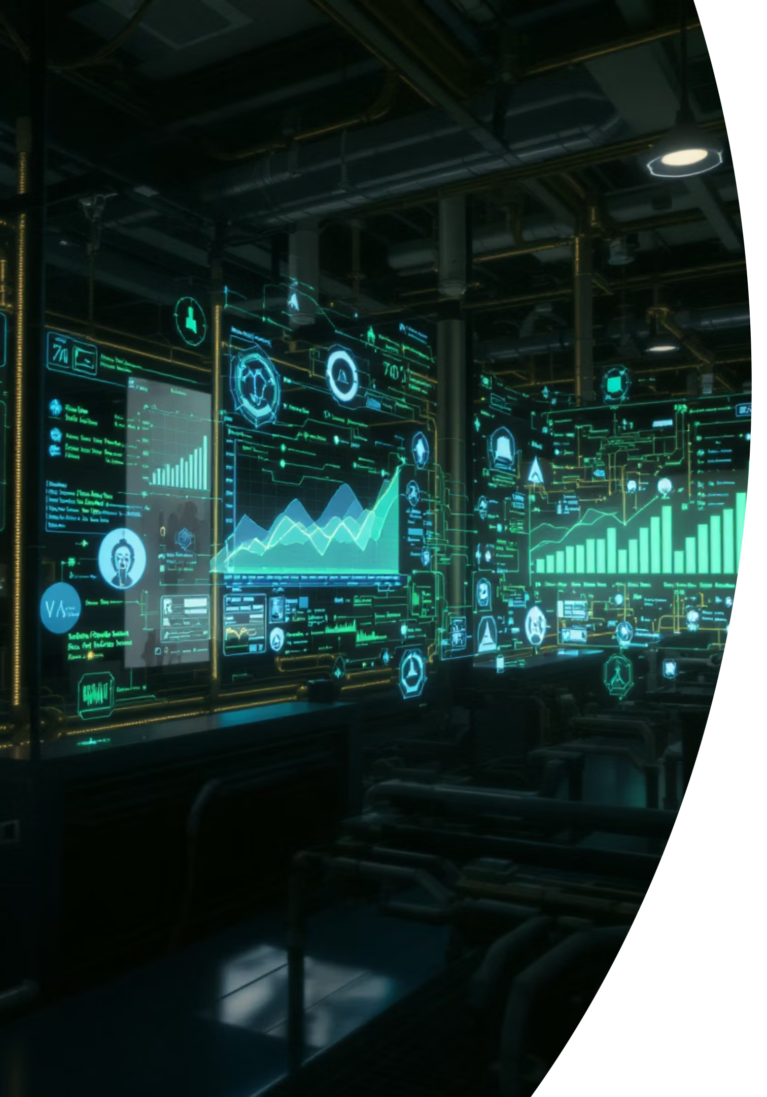
IBM ALP 2
Real-Time Anomaly Detection for IoT Sensor Data
This project demonstrates a real-time anomaly detection system for Internet of Things (IoT) sensor data within a smart manufacturing environment. We simulate sensor readings for temperature, pressure, and vibration, employ an Isolation Forest model for unsupervised anomaly detection, visualize the data live, and provide instant alerts via Telegram.
By Aditya Guha Roy GMBA 24023184

Slide 2
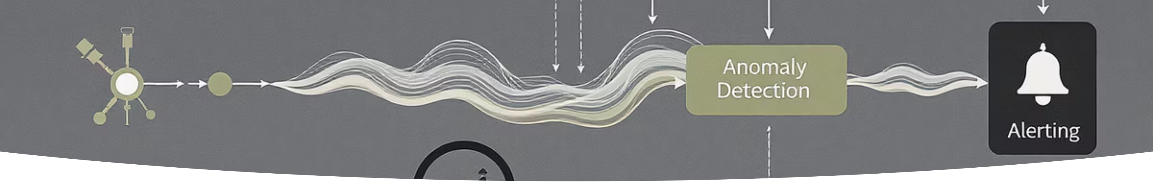




System Architecture
Sensor Data Simulator
Anomaly Detection Model
Generates and streams synthetic temperature, pressure, and vibration readings, mimicking real-world IoT data from manufacturing equipment.
Utilizes an unsupervised Isolation Forest algorithm, trained on simulated normal operational data to identify deviations from expected patterns.
Live Dashboard
Telegram Alerting
A dynamic Plotly FigureWidget visualizes incoming sensor data in real-time, highlighting detected anomalies for immediate operational insights.
Integrates with a Telegram Bot to send instant notifications when an anomaly is detected, ensuring timely intervention.

Slide 3
Prerequisites for Implementation
Development Environment
Required Libraries & Tools
Python 3.x installed (e.g., Google Colab, Jupyter Notebook).
Core: numpy, scikit-learn, plotly.
Familiarity with Python syntax and data structures.
Networking: requests for API calls.
Basic understanding of machine learning concepts and workflows.
Reporting (optional): reportlab.
Telegram Bot Token & Chat ID for alert integration.
Ensure all necessary Python libraries are installed and a valid Telegram Bot token and chat ID are configured for the alerting mechanism.

Slide 4
Detailed Implementation Steps
Configure Environment
Enable third-party Plotly widgets in Google Colab for interactive live visualizations.
Initialize Libraries & Parameters
Import all necessary Python libraries and set crucial system parameters like sliding window size, anomaly injection intervals, and stream delay for simulation realism.
Telegram Alert Function
Develop a dedicated function to send anomaly alerts using the Telegram Bot API, integrating your unique token and chat ID.
Model Training
Train the Isolation Forest model on a dataset of simulated normal sensor readings to establish a baseline for anomaly detection.
Dashboard Setup
Construct a persistent Plotly FigureWidget, defining separate traces for Temperature, Pressure, Vibration, and distinct markers for identified anomalies.
Simulation Loop & Execution
Run the main simulation loop: continuously generate new data, periodically inject synthetic anomalies, execute anomaly detection, update the live dashboard, and dispatch Telegram alerts as needed. Implement mechanisms for graceful termination.

Slide 5
Key Code Components
enable_custom_widget_manager()
train_model()
run_simulation()
This function is responsible for generating a dataset representing normal operational conditions and subsequently training the Isolation Forest anomaly detection model on this data.
The core execution loop of the system, orchestrating data simulation, real-time anomaly detection, dynamic visualization updates on the Plotly dashboard, and immediate Telegram notifications.
Crucial for enabling Plotly's live update capabilities within the Google Colab environment, allowing for dynamic graph rendering without page refreshes.
Deque Buffers
FigureWidget
Utilized as efficient, fixed-size data structures to maintain a sliding window of recent sensor readings, essential for smooth and continuous plotting on the live dashboard.
A powerful Plotly object that supports in-place updates of the same graph, minimizing computational overhead and ensuring a truly live visualization experience.

Slide 6
Deployment & Scaling Considerations
Production Deployment
Real-World Integration & Monitoring
While the prototype operates efficiently in a Google Colab environment, production-grade deployment can leverage containerization technologies like Docker and orchestration platforms such as Kubernetes for robust, scalable, and resilient operation.
Transition from the data simulator to actual real-time data sources like Kafka or MQTT for ingesting sensor data from IoT devices.
For comprehensive system health and performance monitoring at scale, integrate with tools like Prometheus for metrics collection and Grafana for creating interactive dashboards.
This ensures consistency across environments and simplifies management of microservices.
Consider employing more advanced deep learning models such as Autoencoders or LSTMs for detecting intricate and complex anomaly patterns that simple statistical methods might miss.

Slide 7
Future Enhancements & Next Steps
1
Integrate with Physical IoT Devices
Establish direct connections to actual IoT devices using protocols like MQTT or Kafka for authentic real-time data streaming and anomaly detection.
2
Data Persistence for Anomaly Logs
Implement mechanisms to persist detected anomaly events and associated metadata to a robust database (e.g., PostgreSQL, MongoDB) or a distributed file system for historical analysis and auditing.
3
Develop User Interface
Build a dedicated user interface using frameworks such as Streamlit or Flask to provide operators with an intuitive dashboard for monitoring, configuration, and incident management.
4
Establish CI/CD Pipeline
Set up a Continuous Integration/Continuous Deployment (CI/CD) pipeline to automate code testing, building, and deployment processes, ensuring rapid and reliable updates.
5
Optimize Model Parameters
Conduct rigorous hyperparameter tuning and threshold optimization for the anomaly detection model to enhance accuracy, reduce false positives, and improve overall system performance.

Slide 8


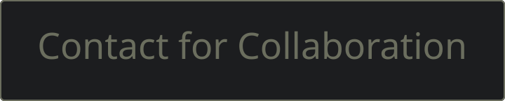
Conclusion: Towards Predictive Maintenance
This project successfully demonstrated an end-to-end pipeline for real-time anomaly detection in an IoT smart manufacturing context. By combining data simulation, unsupervised machine learning with Isolation Forest, live data visualization, and instant alerting, we have created a robust foundational system.
This proof-of-concept serves as a powerful starting point for developing advanced predictive maintenance solutions, enabling proactive intervention, minimizing downtime, and optimizing operational efficiency in industrial environments.

